Slide 1
TEAM ORLANDO
PHP TEAM WORK PROJECT

Slide 2
Our Team
Daniel Tsonkov
Todor Velchev
Plamena Miteva
Nikolay Panayotov

Slide 3
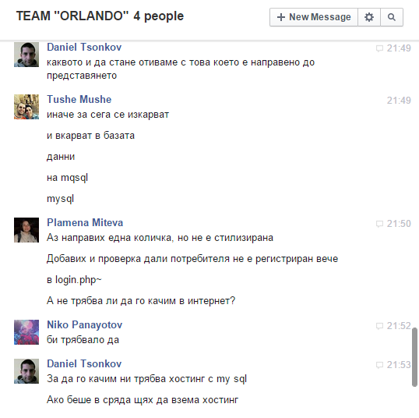

GitHub repository
Facebook chat
github.com/TEAM-ORLANDO

Slide 4

ЕЛЕКТРОНЕН МАГАЗИН
sofiaelectronix.byethost7.com

